Slide 1
Gloucester City High School National Scholarship Fair 2023-2024

Slide 2
October Deadline Scholarships (sponsored by GoMerry)
Heisman High School Scholarship Provider: Acceptance Insurance
Amount: $10,000
Golden Door Scholarship Provider: Golden Door Scholars
Amount: Varies
NSHSS Foundation Business & Public Policy Scholarship Provider: National Society of High School Scholars
Amount: $1,000

Slide 3
October Deadline Scholarships Cont. (sponsored by GoMerry)
The Easiest Scholarship Ever Provider: Going Merry
Amount: $1,000
NSHSS Foundation STEM Scholarship Provider: National Society of High School Scholars
Amount: $1,000
Omega Psi Phi Fraternity, Inc. International High School Essay Contest Provider: Omega Psi Phi Fraternity, Inc.
Amount: $5,000

Slide 4
New Jersey Survivor Tuition Benefits Program & Law Enforcement Officer Memorial Scholarship
Must be a child or surviving spouse of a New Jersey firefighter,emergency service worker or law enforcement officer killed in the line of duty. Deadline 10/1/2023.
NJ Survivor Memorial Scholarship
https://docs.google.com/forms/d/1HzF7X-JSKyJqtYi4sr2C5GvH2drccawj8UrkM3I-i1A/edit?ts=650c466a

Slide 5
$1,000 Plan for College Sweepstakes
Provided by: Sallie Mae
Award -- $1,000
Deadline -- December 31, 2023
Enter the $1,000 Plan for College Sweepstakes by registering for Sallie Mae’s FREE college planning tools, resources, and calculators.* NO ESSAY!

Slide 6
Education Matters Scholarship
Application Deadline: November 30, 2023 Award Amount(s): $5,000 Website: Education Matters Scholarship Details: While continuing your education takes time, and money, there’s a certain value that everyone is hoping to achieve. Our Education Matters Scholarship is giving you the chance to state why education matters. Why does education matter to you? What is the value you hope to receive from college? What would you do to convince the college cynics? Eligibility Requirements: ~Be thirteen (13) years of age or older at the time of application ~Be legal residents of the fifty (50) United States or the District of Columbia ~Be currently enrolled (or enroll no later than the fall of 2026) in an accredited post-secondary institution of higher education

Slide 7
This GRANT is for anyone interested in vocational certification programs: NJ-­‐Governor’s Industry Vocations Scholarship (NJ-­‐GIVS)for Women and Minorities
Must be a female or minority student and have a household income less than $60,000. Scholarship is up to $2,000 per year. Deadline 12/31/23.
https://www.hesaa.org/Documents/NJ-GIVS_program.pdf
https://www.hesaa.org/Documents/NJ-GIVS_factSheet.pdf

Slide 8
Unigo $10K Scholarship
Application Deadline: December 31, 2023
Award Amount(s): $10,000
Website: Unigo $10K Scholarship
Details: Imagine a historical figure is brought back to life. Who is it? What’s their favorite mobile app?
Eligibility Requirements:
Be thirteen (13) years of age or older at the time of application
Be legal residents of the fifty (50) United States or the District of Columbia
Be currently enrolled (or enroll no later than the fall of 2026) in an accredited post-secondary institution of higher education

Slide 9
OppU Achievers Scholarship
Application Deadline: Varying Deadlines Scholarship decisions are based solely on an applicant’s essay response. Winners for the OppU Achievers Scholarship are selected four times a year, with submission deadlines on September 30, December 31, March 31, and June 30. Award Amount(s): $2,500 Website: OppU Achievers Scholarship Details: The OppU Achievers Scholarship celebrates students who transform opportunity into results. It rewards achievement in its many forms and honors those who create opportunity for both themselves and others. Eligibility Requirements
Must be enrolled full time in high school or at least part time in college, graduate, professional, or trade school
Must possess a cumulative GPA of at least 3.0/4.0

Slide 10
Each year, the Program selects numerous recipients to receive a $10,000 scholarship renewable for up to an additional three years – up to $40,000 total per recipient. Awards are for undergraduate study and may be used for education-related expenses, including tuition, fees, books, supplies, room, and board. In addition, Scholars are invited to participate in a special awards program and receive ongoing leadership-development support.
To be eligible for this award, applicants must: GE-Reagan Foundation Scholarship Deadline: TBA
demonstrate at school, at the workplace, and within the community the attributes of leadership, drive, integrity, and citizenship;
demonstrate strong academic performance (minimum 3.0 grade point average/4.0 scale or equivalent);
be citizens of the United States of America;
be current high school seniors attending high school in the United States (students living on U.S. Armed Forces base and homeschooled students are also eligible); and
plan to enroll in a full-time undergraduate course of study toward a bachelor’s degree at an accredited four-year college or university in the United States for the entire upcoming academic year.
Semifinalists will be required to provide a recommendation from a community leader, such as a high school principal, elected official or executive director of a nonprofit organization, and must provide documentation to certify academic performance and financial need. Finalists will be interviewed via Skype or telephone by a member of the selection committee. Learn more about the qualifications of a GE-Reagan Foundation Scholar.
Applicants who have questions about the application process may contact the program’s administrator, Scholarship America, at 1-844-402-0354 and ask for the GE-Reagan Foundation Scholarship Program or email ge-reagan@scholarshipamerica.org. Applicants should anticipate a response to inquiries within one business day. Personnel at GE and The Ronald Reagan Presidential Foundation & Institute cannot address applicant questions.

Slide 11
JFK Profile In Courage Essay Contest
Award: Varies
Deadline: January 12, 2024
Available to: High School Freshman to High School Senior
The JFK Profile in Courage Essay Contest is open to high school students.
To enter, you must submit a 700- to 1,000-word essay that describes an act of political courage by a U.S. elected official that occurred during or after 1917, the year JFK was born.

Slide 12
I Have a Dream Scholarship
Application Deadline: January 31, 2024
Award Amount(s): $1,500 Website: I Have a Dream Scholarship
Details: Let your dreams be your muse – and your ticket to free money for school. One “dreamer” in our I Have a Dream Scholarship will receive $1,500 to help make his or her educational dream come true. Eligibility Requirements:
Must be a legal U.S. resident.
Must be a resident of one of the 50 United States or the District of Columbia. Submit an online written response to the question:
"We want to know... what do you dream about? Whether it's some bizarre dream you had last week, or your hopes for the future, share your dreams with us for a chance to win $1,500 for college." (250 words or less)
The I Have a Dream Scholarship winner will be notified by email or phone on or around April 30, 2021.

Slide 13
RAC Make-A-Difference Scholarship Please check back in Dec 2023 for updated program information
Eligibility
Applicants to the Make A Difference Scholarship Program must be:
Customers in good standing (current customers or customers within the past two years) of Rent-A-Center (includes corporate Rent-A-Center and Rent-A-Center Franchise locations), Get it Now!, Home Choice or Acceptance NOW. OR
Spouses or dependent children of the above customers who are living in the customer’s household. OR
Dependent children, 25 years of age or younger, of current employees of Rent-A-Center (includes corporate Rent-A-Center and Rent-A-Center Franchise locations), Get it Now!, Home Choice, Acceptance NOW or RAC Field Support Center who have been continuously employed for at least one year on February 1, 2019. OR
Dependent children, age 25 or younger, of current Rent-A-Center Franchise owners Applicants must live in the U.S. or Puerto Rico. Applicants must be high school seniors or graduates who plan to enroll or students already enrolled in full-time undergraduate study at an accredited two- or four-year college, university or vocational-technical school in the United States or Puerto Rico for the entire upcoming academic year. Applicants must be studying to obtain their first bachelor’s degree. Applicants must have a minimum cumulative grade point average of at least 2.00 on a 4.00 scale (or its equivalent).

Slide 14
The Sam Haskell Scholarship
Application Deadline: March 1, 2024 Award Amount(s): $1,000 Website: The Sam Haskell Scholarship
Details: Sam Haskell founded this annual scholarship with the understanding that many students do not have the financial means to further their education. The Sam Haskell Scholarship will award one high school senior, current college, or graduate student with a $1,000 scholarship.
Eligibility Requirements:
Current high school senior with a college or university acceptance.
Current college or graduate student.
Must provide proof of enrollment or acceptance.

Slide 15
Annual Create-A-Greeting-Card $10,000 Scholarship Contest
Submit original photo, artwork or computer graphics for the front of a greeting card.
Deadline: 3/1/24.
Winner will be announced May 13th, 2022.
Age Eligibility: Must be 14 years or older at time of entry and be enrolled in High School, College, University or Homeschool.
The finalists will again be decided by voting!

Slide 16
Milk Mustache Scholarship Deadline: March 12, 2024
Applicants must be legal residents of the 48 contiguous United States or the District of Columbia, be high school seniors, have a minimum 3.2 GPA and participate in a high school or club sport. Applicants must describe in 75 words or less how drinking milk has been a part of their life and training regimen.

Slide 17
The ICMA-RC Public Employee Memorial Scholarship Fund (ICMA-RC Memorial Scholarship Fund) was founded in 2001 to honor the lives of our nation's police officers, firefighters, and other local and state government employees who have made the ultimate sacrifice.
The fund provides financial assistance to the surviving spouses and children of employees who have died in the line of duty and are planning to attend an accredited two-year community college, four-year accredited university, or vocational school full-time.
Children and spouses of local and state government employees who have died in the line of duty may apply for the ICMA-RC Public Employee Memorial Scholarship Fund.
The applicant must provide a letter from the deceased employee's place of work.
The applicant must currently attend or plan to attend school full-time at an accredited two-year community college, four-year accredited university, or vocational school at the time of application.
Study can be at the undergraduate, graduate, or technical level.
Awards are granted without regard to race, color, creed, religion, age, gender, disability, or national origin.
Applications are accepted annually from December 15 – March 15. They must be mailed to Scholarship America at the address below, along with a current complete official transcript postmarked no later than March 15 of each year. Online transcripts and grade reports are not accepted.
ICMA-RC Public Employee Memorial Scholarship Fund Scholarship America One Scholarship Way St. Peter, MN 56082 Telephone: (202) 962-8067
ICMA-RC Memorial Scholarship Deadline: March 15, 2024

Slide 18
Superpower Scholarship
Application Deadline: March 31, 2024 Award Amount(s): $2,500 Website: Superpower Scholarship Details: While we can’t give you the ability to walk through walls or read minds, our Superpower Scholarship can help increase your brainpower with $2,500 to use towards education. Eligibility Requirements:
Must be a legal U.S. resident.
Must be a resident of one of the 50 United States or the District of Columbia Submit an online written response to the question:
"Which superhero or villain would you want to change places with for a day and why?" (250 words or less)
The Superpower Scholarship winner will be notified by email or phone on or around June 30.

Slide 19
John Starks Foundation Scholarship Deadline: May 1, 2024
The “3 Point Scholarship Program” has been designed to assist New York/Tri-State & Tulsa area high school students in their pursuit of a college degree. $2,000 grants will be available to graduating high school seniors who plan to enroll full-time at a two-year or four-year accredited institution during the upcoming academic year.
Students who remain in good standing academically during their freshman year will be given consideration to reapply for additional financial assistance through the program. By signing this application, it is understood that any student who violates any program policies, including, but not limited to illegal, unethical or immoral conduct, may have his/her scholarship revoked and/or not renewed.
ELIGIBILITY REQUIREMENTS
1). Minimum cumulative GPA of 3.00 on a 4.00 scale (or the equivalent).
2). Financial Need – attach copies of head of household’s most recent tax returns.
3). Commitment to community service – attach a detailed list your activities.
Please submit the following with your completed application:
A). An official high school transcript (originals only) – in a sealed envelope.
B). Two (2) letters of recommendation – school official, current or former employer

Slide 20
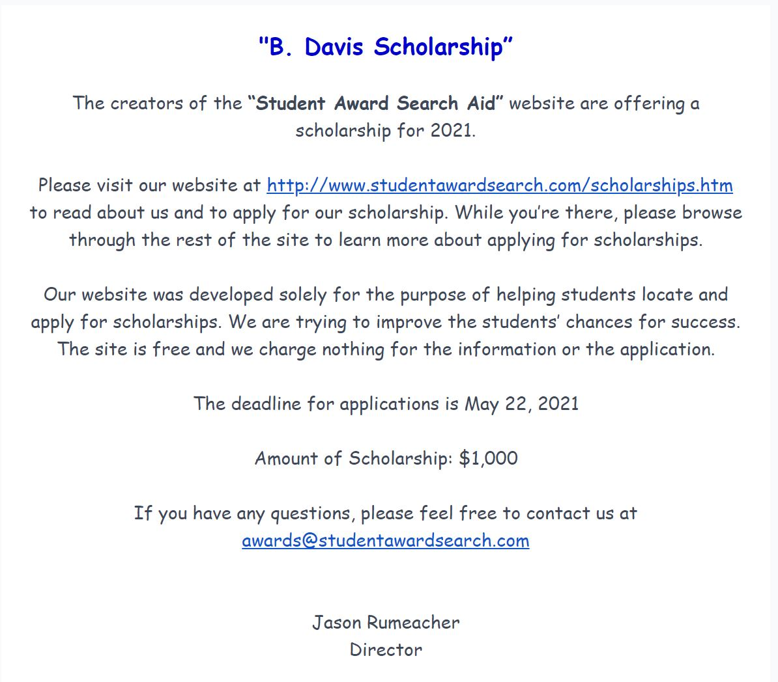
B. Davis Scholarship Link Deadline: May 21, 2024

Slide 21
NJ ROFL Scholarship Deadline: May 30, 2024
Welcome to the New Jersey ROFL (rolling on floor laughing) scholarship! At Pointe Pest Control we believe school is important, but paying for school is not always easy. We want to give back to the community by providing this scholarship to any high school senior or college freshman from New Jersey. Take a quick break from your studies and create something funny for a chance to win a $500 scholarship.
The scholarship must be submitted, in full, by May 30, 2024. NO LATE APPLICATIONS WILL NOT BE CONSIDERED.
INCOMPLETE APPLICATIONS WILL NOT BE CONSIDERED.
Applications for scholarship can be submitted by any high school senior or college freshman from the state of New Jersey.

Slide 22
Bee Winkler Weinstein Fund
Award: Varies
Deadline: Varies
Available to: College Freshman through College Senior
The Bee Winkler Weinstein Fund is available to lesbians, bisexual women, and female identified transgender individuals ages 18-25 whose own families have withdrawn emotional and/or financial support because of their sexual and/or gender identity.
This award promotes growth and self-sufficiency in young women by providing grants covering vocational/ technical training, licensing fees, college application fees and the like.
Applicants must reside within the United States to be eligible for this award.

Slide 23
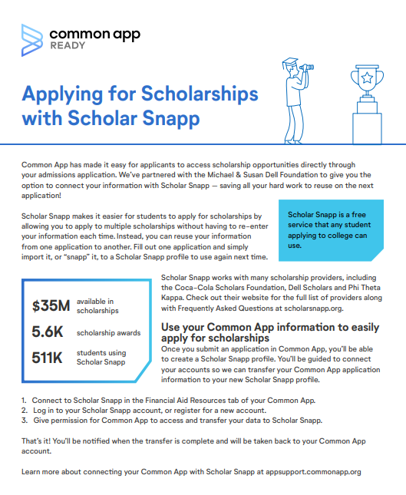
DON’T FORGET TO CHECK OUT THIS GREAT RESOURCE FOR NATIONAL SCHOLARSHIPS THROUGH THE COMMON APP WEBSITE!

Slide 24
CHECK OUT THESE WEBSITES THAT HOUSE HUNDREDS OF SCHOLARSHIPS!
Scholarships.com
Fastweb.com
College Board Big Future Scholarship Search
Dollars For Scholars
hesaa.org
Best College Scholarships 2020
Sallie Mae Scholarships
UNIGO Scholarships

